Slide 1

Food or Recipe Recommendations
In this presentation, we will explore a recipe recommendation system designed to suggest dishes tailored to users' dietary preferences, cooking habits, and previous restaurant choices.

Slide 2
Introduction
Project Goal
This project focuses on building a recipe recommendation system that tailors recipe suggestions based on users' dietary preferences and ingredient inputs. By leveraging nutritional features such as calories, fat, carbohydrates, and protein, alongside the ingredients list, the system provides personalized recommendations to suit diverse culinary needs.

Slide 3
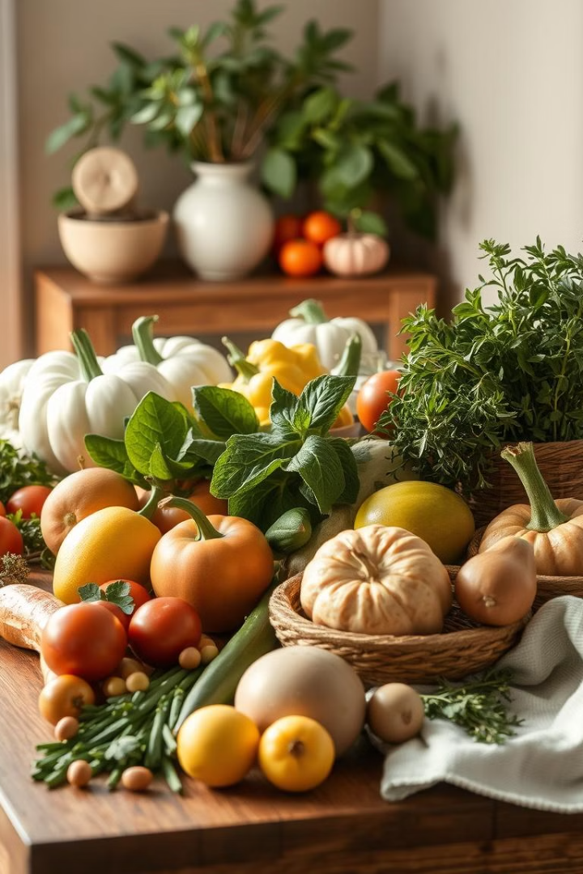
Dataset Overview
Recipe Name
Ingredients List
Calories
Image URL
Grilled Salmon
Salmon, olive oil, lemon, salt, pepper
350
www.example.com/grilled-salmon.jpg
Vegetable Stir-Fry
Broccoli, carrots, bell peppers, soy sauce, garlic
280
www.example.com/vegetable-stir-fry.jpg
Chocolate Chip Cookies
Flour, butter, sugar, chocolate chips, eggs
220
www.example.com/chocolate-chip-cookies.jpg
The dataset contains detailed information about recipes, including ingredients, nutritional values, and images.(14 , 48736)

Slide 4

Data Preprocessing
1
Textual Data (Ingredients)
2
Numerical Data (Nutritional Features)
Used TF-IDF Vectorizer to convert text into numerical features.
Standardized features like calories, fat, and protein using StandardScaler.
3
Combined Features
Merged numerical and textual features using np.hstack.

Slide 5

KNN Model Training
Algorithm
Metric
Parameters
K-Nearest Neighbors (KNN)
Cosine Similarity
5 neighbors

Slide 6
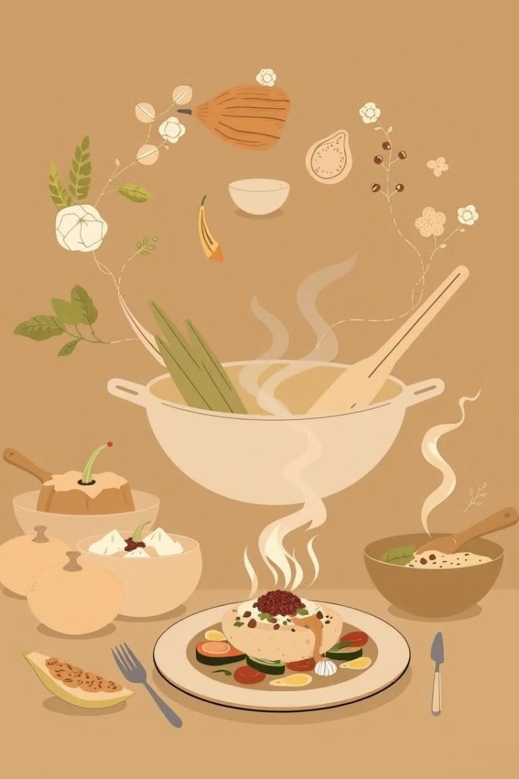
Recommendation Function
1
Input
Nutritional values + ingredient list
2
Processing
Normalize numerical features, transform ingredient list with TF-IDF, combine features and query the KNN model.
3
Output
Top 5 recipe suggestions

Slide 7
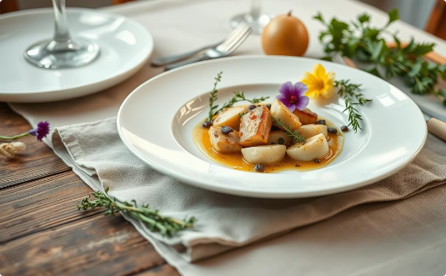
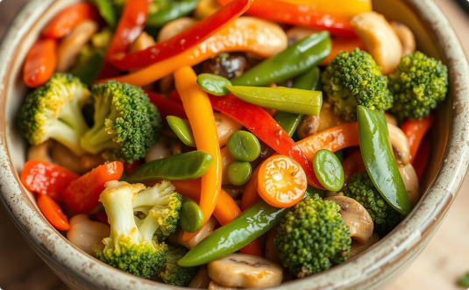
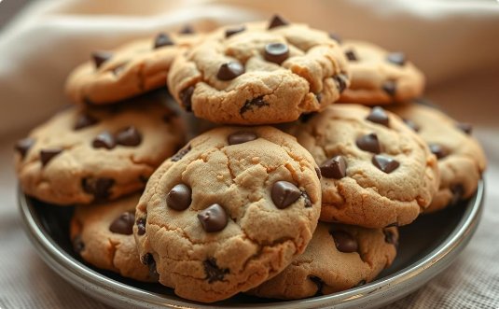
Visualizing Recommendations
Grilled Salmon
Vegetable Stir-Fry
Chocolate Chip Cookies

Slide 8
Example Input and Output
Input
Output
Calories: 350, Protein: 25g, Carbs: 20g, Ingredients: Salmon, olive oil, lemon, salt, pepper
1. Grilled Salmon 2. Baked Salmon with Lemon Butter 3. Salmon Teriyaki 4. Salmon Cakes 5. Salmon Burgers

Slide 9

Conclusion and Future Work
Summary
Future Directions
Built a functional recipe recommendation system using KNN and TF-IDF.
Enhance recommendations using user feedback and explore deep learning models for personalization.

